Slide 1
Chapter 7 Dynamic Routing
Speaker: H.M. Liang

Slide 2
Graph abstraction
5
v
3
w
2
5
u
2
1
z
3
1
2
x
y
1
Graph: G = (N,E)
N = set of routers = { u, v, w, x, y, z }
E = set of links ={ (u,v), (u,x), (v,x), (v,w), (x,w), (x,y), (w,y), (w,z), (y,z) }
Remark: Graph abstraction is useful in other network contexts
Example: P2P, where N is set of peers and E is set of TCP connections

Slide 3
Graph abstraction: costs
5
c(x,x’) = cost of link (x,x’)
- e.g., c(w,z) = 5
cost could always be 1, or
inversely related to bandwidth,
or inversely related to
congestion
v
3
w
2
5
u
2
1
z
3
1
2
x
y
1
Cost of path (x₁, x₂, x₃,…, x_{p}) = c(x₁,x₂) + c(x₂,x₃) + … + c(x_{p-1},x_{p})
Question: What’s the least-cost path between u and z ?
Routing algorithm: find “good” paths from source to
destination router.

Slide 4
Routing Algorithm Classification
1. Global, decentralized ?
Global:
all routers have complete topology, link cost info
“link state” algorithms
Decentralized:
router knows about physically-connected neighbors
Iterative, distributed computations
“distance vector” algorithms
2. Static, dynamic?
Static:
routes change slowly over time
Dynamic:
routes change more quickly
  periodic update
  in response to link cost changes
3. Load sensitivity?
  Many Internet routing algos are load insensitive

Slide 5
A Link-State Routing Algorithm
Dijkstra’s algorithm
net topology, link costs known to all nodes
  accomplished via “link state broadcast”
  all nodes have same info
computes least cost paths from one node (‘source”) to all other nodes
  gives forwarding table for that node
iterative: after k iterations, know least cost path to k dest.’s
Notation:
c(x,y): link cost from node x to y; = ∞ if not direct neighbors
D(v): current value of cost of path from source to dest. v
p(v): predecessor node along path from source to v
N': set of nodes whose least cost path definitively known

Slide 6
Dijsktra’s Algorithm
1 Initialization:
2 N' = {u}
3 for all nodes v
4 if v adjacent to u
5 then D(v) = c(u,v)
6 else D(v) = ∞
7
8 Loop
9 find w not in N' such that D(w) is a minimum
10 add w to N'
11 update D(v) for all v adjacent to w and not in N' :
12 D(v) = min( D(v), D(w) + c(w,v) )
13 /* new cost to v is either old cost to v or known
14 shortest path cost to w plus cost from w to v */
15 until all nodes in N'

Slide 7
Dijkstra’s algorithm: example
Step
0
1
2
3
4
5
N'
u
ux
uxy
uxyv
uxyvw
uxyvwz
D(v),p(v)
2,u
2,u
2,u
D(w),p(w)
5,u
4,x
3,y
3,y
D(x),p(x)
1,u
D(y),p(y)
∞
2,x
D(z),p(z)
∞
∞
4,y
4,y
4,y
5
v
3
w
2
5
u
2
1
z
3
1
2
x
y
1

Slide 8
Dijkstra’s algorithm, discussion
Algorithm complexity: n nodes
each iteration: need to check all nodes, w, not in N
n(n+1)/2 comparisons: O(n²)
more efficient implementations possible: O(nlogn)
Oscillations possible:
e.g., link cost = amount of carried traffic
1
A
A
A
A
1+e
2+e
0
0
2+e
2+e
0
D
0
0
B
D
B
D
B
D
B
1+e
1
0
0
1+e
1
0
e
0
0
1
1+e
0
0
C
C
C
C
1
1
e
… recompute
routing
… recompute
… recompute
initially

Slide 9
Distance Vector Algorithm (1)
Bellman-Ford Equation (dynamic programming)
Define
d_{x}(y) := cost of least-cost path from x to y
Then
d_{x}(y) = min {c(x,v) + d_{v}(y) }
where min is taken over all neighbors of x
Notes:
The assumptions for DV are:
1) each node knows the costs to each of its neighbors
2) a “dead” link is assigned infinite cost
3) routes are updated
- periodically (to inform others that the node is alive)
- when routes are updated

Slide 10
Bellman-Ford example (2)
5
Clearly, d_{v}(z) = 5, d_{x}(z) = 3, d_{w}(z) = 3
v
3
w
2
5
u
z
B-F equation says:
2
1
3
1
2
d_{u}(z) = min { c(u,v) + d_{v}(z),
c(u,x) + d_{x}(z),
c(u,w) + d_{w}(z) }
= min {2 + 5,
1 + 3,
5 + 3} = 4
x
y
1
Node that achieves minimum is next
hop in shortest path ➜ forwarding table
Notes:
Just to reaffirm the idea behind Bellman-Ford Equations

Slide 11
Routing in NS-2
Four routing strategies:
  Static
  Session
  Dynamic
  Manual
Default in NS-2 : Static routing on all the nodes in the topology
Dijkstra’s all-pairs SPF algorithm
Distributed Bellman-Ford algorithm

Slide 12
Command in NS-2
Enable static route strategy for the simulation
  $ns rtproto Static
Enable session routing for this simulation
  $ns rtproto Session
Run DV agents on nodes $n1, $n2, and $n3
  $ns rtproto DV $n1 $n2 $n3
Run link state routing on specified nodes
  $ns rtproto LS $n1 $n2

Slide 13
Command in NS-2
Link Cost Assignment and Control
  $ns cost $n1 $n2 10
  $ns cost $n2 $n1 5
  [$ns link $n1 $n2 ] cost?
  [$ns link $n1 $n2 ] cost?
The default cost of a link is 1

Slide 14
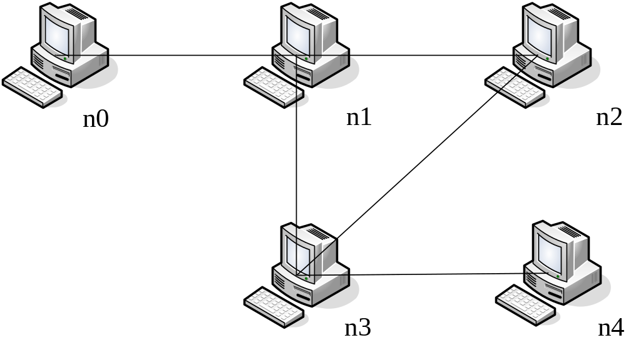
Experiment topology

